Slide 1

Summer 2026
Longhorn hapkit
Lab guide #3
Ross neuman
Assistant Professor of Practice, The University of Texas at Austin

Slide 2
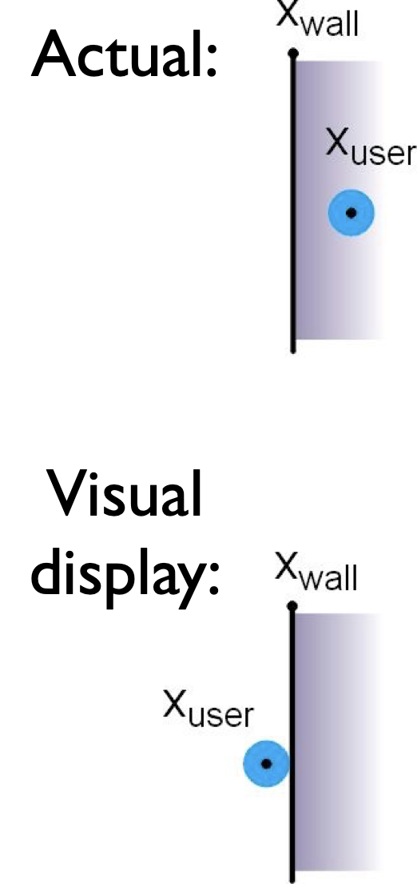
One more way to make a wall better: Visual Feedback of Stiffness
trick: never show the point passing into the surface, even if it is!
psychophysical studies have shown that this makes the surface appear stiffer to the user

Slide 3
Python!
Let’s use Python to interact with the hapkit
Open a new terminal tab or window (the one running arduino needs to keep running arduino, don’t mess with it)
You should be in your home directory when you do this
The command “pwd” prints your working directory, which should read /u/horns<yournumber> if you are in your home directory
A shortcut back to your home directory if you ever need is “cd ~”

Slide 4
Virtual Environments
A virtual environment is an isolated Python workspace for a specific project
It contains its own Python interpreter and installed packages
Packages installed in the venv do not affect the system Python installation
You can make as many as you need
If you want to share your project, you can create a dependency file (e.g., requirements.txt) so others can recreate the same environment
On these computers you need to be in one to install new Python packages

Slide 5
Making a Virtual Environment
In your terminal type
python3 –m venv <myvenv>
This creates a new folder named <myvenv> with its own Python executable and its own directories for installed packages
Activation scripts are installed
In the terminal type
source <myvenv>/bin/activate
You now have activated the virtual environment in this terminal
You can download packages now

Slide 6
Download PySerial, Try Example
With your activated environment install PySerial
pip install pyserial
“pip” contacts the Python Package Index to find the pyserial package
It then downloads the package files and any required dependencies and installs into the currently active Python environment

Slide 7
Try out an example
On the github, download or copy/paste into a text editor the “hapkitCommands.py” file
This file accompanies the spring_wall_damper_ISR.ino arduino sketch
Run the arduino sketch
In your terminal, navigate to the directory where you have placed “hapkitCommands.py” and type:
python hapkitCommands.py
You should now be able to command the hapkit from your terminal using python

Slide 8
Writing New Code
You can write new python scripts in any text editor and save the file with a .py extension
Looks like these computers have vscode, idle, vim, etc. so just take your pick

Slide 9
Resources
Python tutorial https://docs.python.org/3/tutorial/index.html
Feel free to use whatever tutorial you find useful
Navigating linux directories https://docs.ycrc.yale.edu/PIL/02-filedir/
Python packages that may be useful
tkinter is great for building GUIs and basic games
pygame is more geared toward games, can do 3D
pygame.mixer can even add sound effects which can enhance haptic realism!
matplotlib for more scientific visualization, plotting
pyqtgraph good for live data streams
numpy for fast, advanced math operations
scipy for scientific computing (signal processing, filtering, optimization)
pandas for data logging – save files as CSVs and whatnot
Some campers are also getting great results using HTML

Slide 10
Go forth and create
This was a super simple example, but you can now use the vast world of python packages to create GUIs, games, link kits together, etc.
Feel free to use LLMs, but please try and read the code they generate to understand what is going on
Vibe code your hearts out if you want but
Ask the LLM why things are the way they are!
Share with the camp!
There’s new directory in the github called camper_scripts
Upload your own folder with your required files and a readme to get people up to speed if they want to try it out on their own

